Slide 1
Team: NotNeuralNetworks
Saurabh Singh (20194116)
Rahul Gupta (20190027)
Niteeq Sheik (20194115)

Slide 2
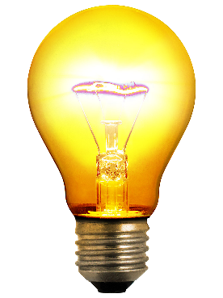
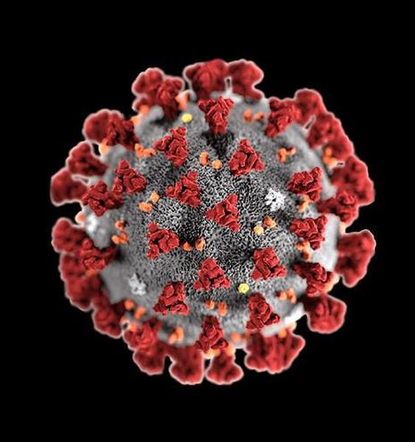
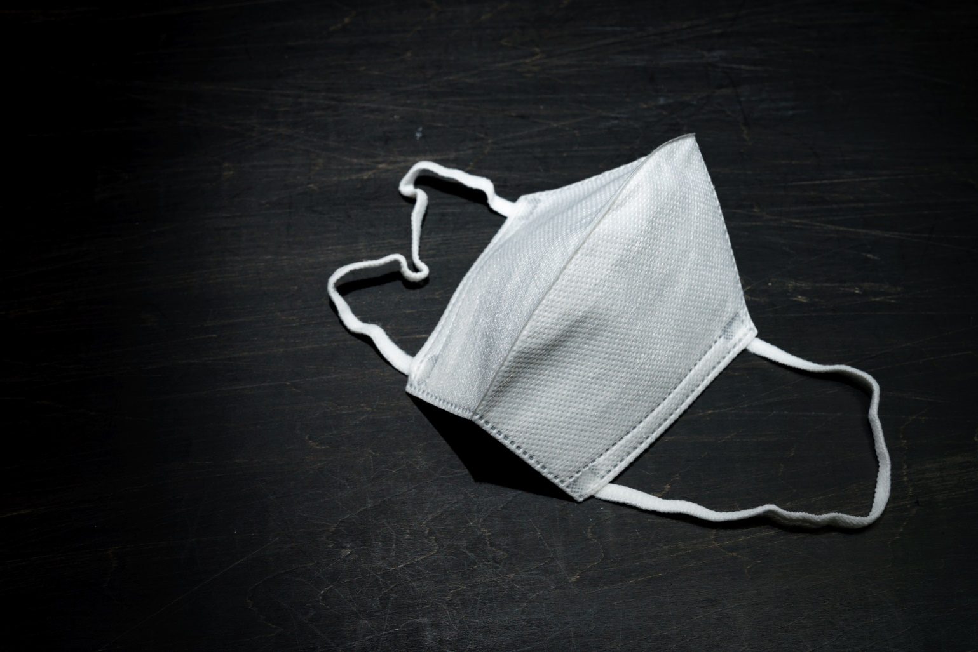
Idea of the project:
In the present scenario of COVID-19, the use of masks has become essential for everyone. Seeing this, our team has come up with the idea of developing a software that detects if a person is wearing a mask or not.

Slide 3
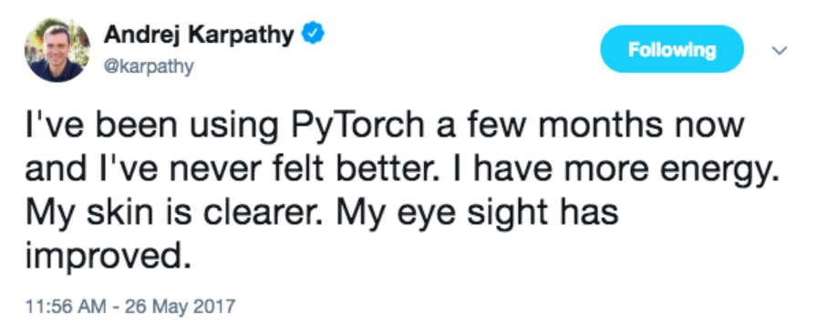

Which framework are we using for Deep Learning?
We’ve used PyTorch for building our project simple because it is easy to use and very similar to Python. Also, let’s not forget this legendary tweet by Andrej Karpathy:

Slide 4

Google Colaboratory:
Thanks to this wonderful service provided by Google which helped us use their GPU for faster training of our model and provided us with over 12RAM of space.
Kaggle Kernel was an alternative but we used Colaboratory as the mounting of Google Drive was easier and our dataset was on Google Drive so that all of us can access it in the lockdown.

Slide 5
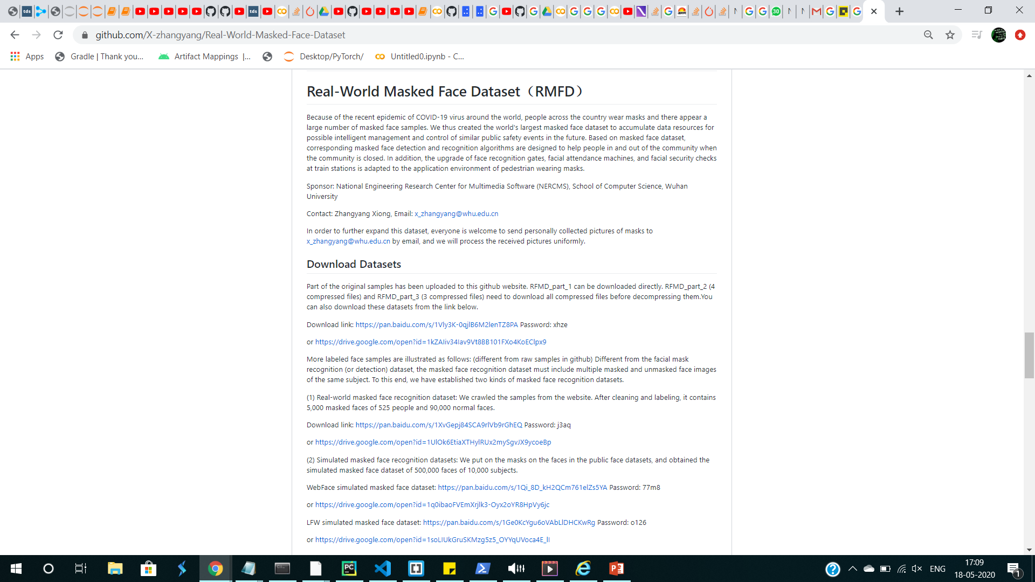
Where did we get out dataset?
Most of our data came from RMFD and other sources we got our data from are mentioned below. Together they made up 5k masked images and 5k unmasked images. Out of which 9k were used for training and 1k for validation. (1:1)
https://github.com/prajnasb/observations/tree/master/experiements/data
https://www.kaggle.com/vtech6/medical-masks-dataset

Slide 6
Directory structure of our Dataset:
Masked Dataset
Trainset
Validationset
Masked
Unmasked
Masked
Unmasked
The ImageFolder utility in PyTorch will help us use the subdirectories of Validationset and Trainset as the labels.

Slide 7
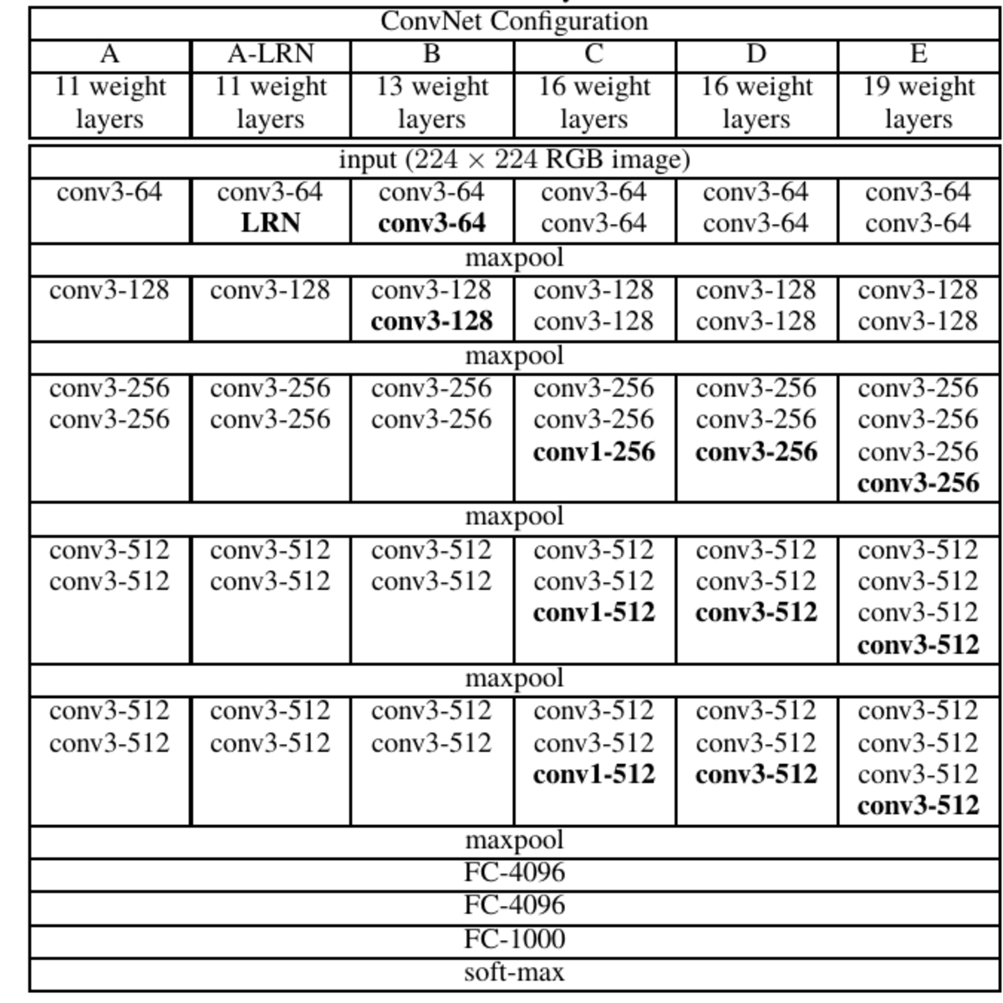
What is the architecture of our model?
The model architecture we’re going to use for our project is going to be VGG19 architecture. But the code we have is quite generalised and can be used for the above shown layers too.

Slide 8
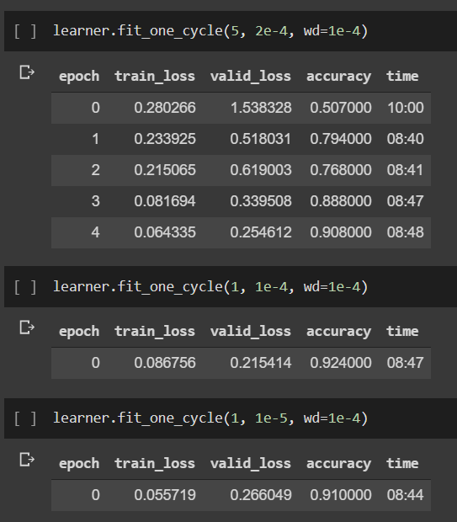
Training Complete:
Above is the glimpse of our training process.
We ran it for 30 epochs later on and it reached an accuracy of 91%.

Slide 9
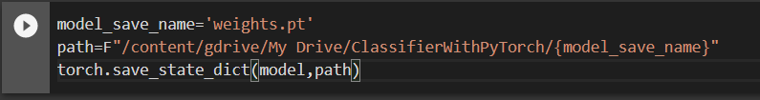
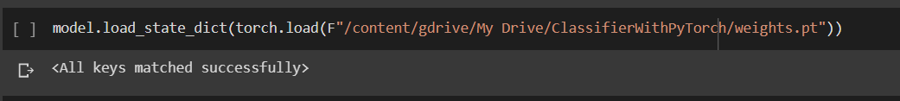
Saving the trained parameters:
Then we save the model parameters so that we can load them later for our project. We save them into a weight.pt file (611MB) using the below operation:
Then whenever we want to access it, we can load the parameters into our model using weights.pt by specifying the path of the file:

Slide 10
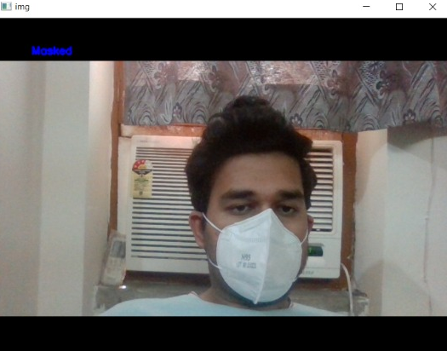
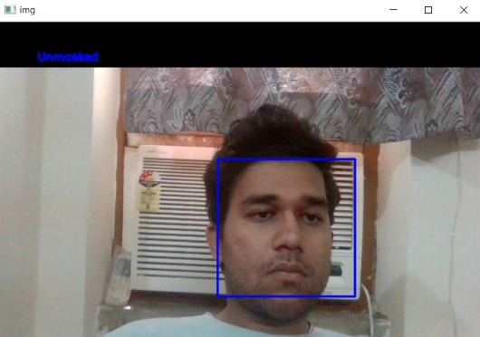
Using OpenCV for Realtime detection and outputs:
We tested it out on our webcam. The output can be seen on top left. We used the cv2 module and its functionalities to achieve this.

Slide 11
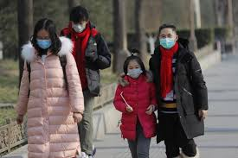
Applications of our project: How we can extend our model for betterment
We can add a counter and see what percentage of the population is wearing masks. We can save this statistics for several days in our database and see how awareness increased regarding the issue.
We could use it in buildings and apartments and not allow unmasked people to enter while also managing a database of images of defaulters.

